Slide 1
Application of Security Principles
Ryan Coon
CYB-515
Dr. Edward Marchewka
October 23, 2024

Slide 2
Table of Contents
Introduction
Security Design Failures
CIA Triad
How the Failures relate to the CIA Triad
Design Principles Involved or Needed for Remote Workers
References

Slide 3
Introduction
A remote work policy is a set of guidelines that outline the expectations of both the employer and employees when work is being done outside of the traditional office setting. It defines remote work arrangements, offers guidance for effective remote work practices, and ensures that remote work doesn't negatively impact colleagues' workload or productivity.
The following presentation will highlight some common Security Design Failures related to remote workers, while also showcasing some best practices in respect to cybersecurity.
Notes:
NordLayer. (2023, August 29). Creating a successful remote work policy: examples and best practices. Nordlayer.com. https://nordlayer.com/blog/remote-work-policy-examples/

Slide 4
Security Design Failures
Inadequate Home Network Security
Failure: Employees working from home often use unsecured Wi-Fi networks, leaving their devices and company data vulnerable to attacks.
Violated Principle: Least Privilege: Users should only have access to the resources they need to perform their jobs. In this case, employees working from home should be using a secure VPN connection to access company resources, limiting access to the company network.
Notes:
Imperva. (2023). Information Security: The Ultimate Guide. Learning Center. https://www.imperva.com/learn/data-security/information-security-infosec/
Pratt, M. K. (2024, March 21). Remote Work Cybersecurity: 12 Risks and How to Prevent Them. SearchSecurity. https://www.techtarget.com/searchsecurity/tip/Remote-work-cybersecurity-12-risks-and-how-to-prevent-them
Rathod, F. (2024, June 27). Cybersecurity in the Age of Remote Work: Best Practices for Secure Telecommuting. Linkedin.com. https://www.linkedin.com/pulse/cybersecurity-age-remote-work-best-practices-secure-falgun-rathod-naknf
redcentric. (2021, September 17). The top 5 security concerns of remote working. Redcentric. https://www.redcentricplc.com/network-security/top-5-security-concerns-of-remote-working/
Worthington, H. O., David. (2023, August 8). 17 Remote Work Security Risks & Best Practices. JumpCloud. https://jumpcloud.com/blog/remote-work-security-risks

Slide 5
Security Design Failures
Insufficient Data Loss Prevention
Failure: Companies may not have effective data loss prevention (DLP) measures in place to prevent sensitive information from being leaked or stolen from remote devices.
Violated Principle: Data Integrity and Confidentiality: Data must be protected from unauthorized access, use, disclosure, modification, or destruction. DLP solutions help to ensure that sensitive data is not accidentally or intentionally leaked from remote devices.
Notes:
Imperva. (2023). Information Security: The Ultimate Guide. Learning Center. https://www.imperva.com/learn/data-security/information-security-infosec/
Pratt, M. K. (2024, March 21). Remote Work Cybersecurity: 12 Risks and How to Prevent Them. SearchSecurity. https://www.techtarget.com/searchsecurity/tip/Remote-work-cybersecurity-12-risks-and-how-to-prevent-them
Rathod, F. (2024, June 27). Cybersecurity in the Age of Remote Work: Best Practices for Secure Telecommuting. Linkedin.com. https://www.linkedin.com/pulse/cybersecurity-age-remote-work-best-practices-secure-falgun-rathod-naknf
redcentric. (2021, September 17). The top 5 security concerns of remote working. Redcentric. https://www.redcentricplc.com/network-security/top-5-security-concerns-of-remote-working/
Worthington, H. O., David. (2023, August 8). 17 Remote Work Security Risks & Best Practices. JumpCloud. https://jumpcloud.com/blog/remote-work-security-risks

Slide 6
Security Design Failures
Unsecured Remote Access
Failure: Companies may not implement strong authentication measures for remote access, such as multi-factor authentication (MFA) or robust password policies.
Violated Principle: Authentication and Authorization: Access to company systems should be restricted to authorized users and based on their roles and responsibilities. MFA and strong passwords ensure that only authorized users can access company systems.
Notes:
Imperva. (2023). Information Security: The Ultimate Guide. Learning Center. https://www.imperva.com/learn/data-security/information-security-infosec/
Pratt, M. K. (2024, March 21). Remote Work Cybersecurity: 12 Risks and How to Prevent Them. SearchSecurity. https://www.techtarget.com/searchsecurity/tip/Remote-work-cybersecurity-12-risks-and-how-to-prevent-them
Rathod, F. (2024, June 27). Cybersecurity in the Age of Remote Work: Best Practices for Secure Telecommuting. Linkedin.com. https://www.linkedin.com/pulse/cybersecurity-age-remote-work-best-practices-secure-falgun-rathod-naknf
redcentric. (2021, September 17). The top 5 security concerns of remote working. Redcentric. https://www.redcentricplc.com/network-security/top-5-security-concerns-of-remote-working/
Worthington, H. O., David. (2023, August 8). 17 Remote Work Security Risks & Best Practices. JumpCloud. https://jumpcloud.com/blog/remote-work-security-risks

Slide 7
Security Design Failures
Lack of Endpoint Security
Failure: Employees' personal devices, often used for remote work, may lack adequate security software, such as antivirus, firewalls, and intrusion detection systems.
Violated Principle: Defense in Depth: Multiple layers of security should be implemented to protect sensitive data. Endpoint security measures are crucial for protecting devices from malware and other threats.
Notes:
Imperva. (2023). Information Security: The Ultimate Guide. Learning Center. https://www.imperva.com/learn/data-security/information-security-infosec/
Pratt, M. K. (2024, March 21). Remote Work Cybersecurity: 12 Risks and How to Prevent Them. SearchSecurity. https://www.techtarget.com/searchsecurity/tip/Remote-work-cybersecurity-12-risks-and-how-to-prevent-them
Rathod, F. (2024, June 27). Cybersecurity in the Age of Remote Work: Best Practices for Secure Telecommuting. Linkedin.com. https://www.linkedin.com/pulse/cybersecurity-age-remote-work-best-practices-secure-falgun-rathod-naknf
redcentric. (2021, September 17). The top 5 security concerns of remote working. Redcentric. https://www.redcentricplc.com/network-security/top-5-security-concerns-of-remote-working/
Worthington, H. O., David. (2023, August 8). 17 Remote Work Security Risks & Best Practices. JumpCloud. https://jumpcloud.com/blog/remote-work-security-risks

Slide 8
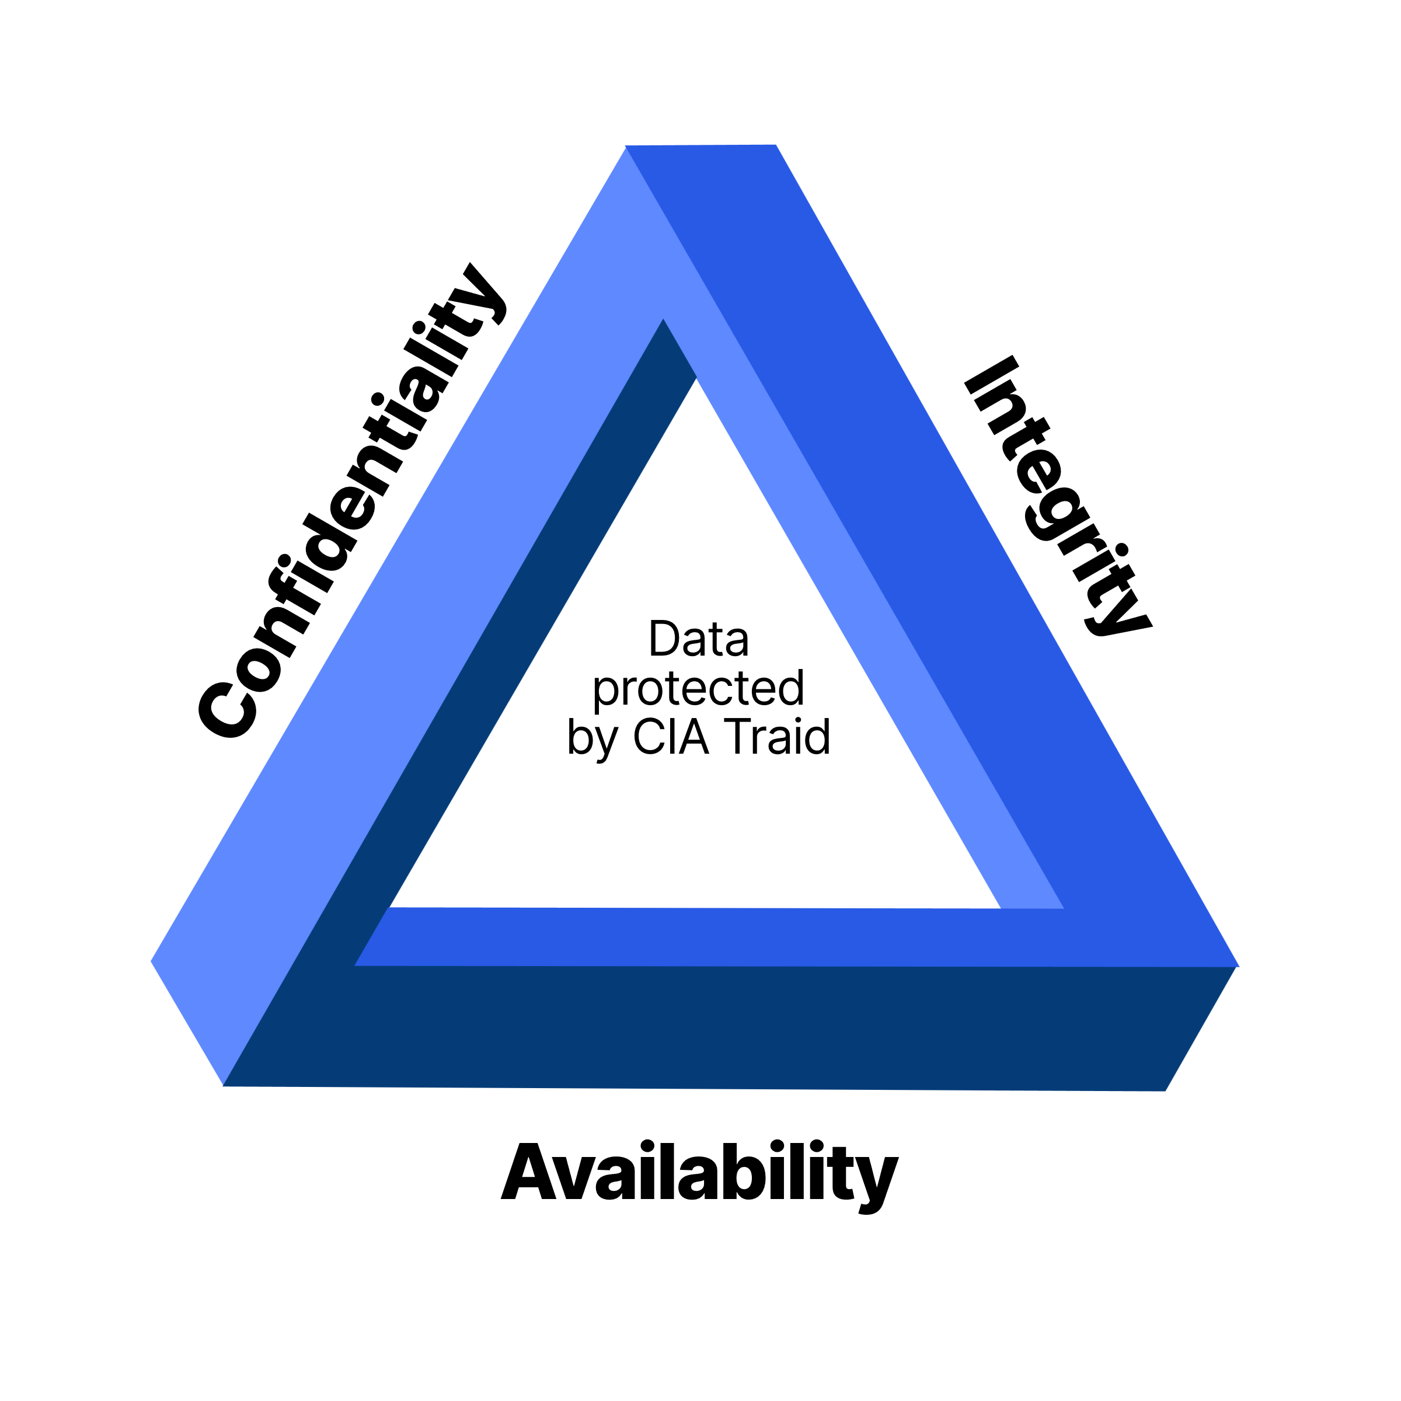
CIA Triad
The CIA Triad is a fundamental model in information security that stands for Confidentiality, Integrity, and Availability. It's a guiding principle for organizations to ensure the security of their data and systems.
Confidentiality means protecting information from unauthorized access. This involves ensuring that only authorized individuals can view and use sensitive data.
Integrity refers to maintaining the accuracy and completeness of information. It ensures that data is not altered or corrupted without authorization.
Availability means ensuring that information and systems are accessible to authorized users when needed. This involves preventing disruptions or outages that could hinder access to critical data.
Notes:
Fortinet. (2024). What is the CIA Triad and Why is it important? Fortinet. https://www.fortinet.com/resources/cyberglossary/cia-triad
Hashemi-Pour, C. (2023, December). What is the CIA Triad? Definition, Explanation and Examples. TechTarget. https://www.techtarget.com/whatis/definition/Confidentiality-integrity-and-availability-CIA

Slide 9
How the Failures relate to the CIA Triad
Inadequate Home Network Security
Confidentiality: An unsecured home network can be easily accessed by attackers, putting sensitive company data stored on employee devices at risk of being intercepted or stolen.
Insufficient Data Loss Prevention
Confidentiality: Without proper DLP measures, sensitive data can be easily leaked or stolen from remote devices, violating confidentiality principles.
Unsecured Remote Access
Integrity: Unsecured remote access can make it easier for attackers to modify or corrupt data stored on company systems, compromising data integrity.
Lack of Endpoint Security
Availability: Malware infections can cause system crashes and disruptions, affecting availability.
Notes:
Fortinet. (2024). What is the CIA Triad and Why is it important? Fortinet. https://www.fortinet.com/resources/cyberglossary/cia-triad
Imperva. (2023). Information Security: The Ultimate Guide. Learning Center. https://www.imperva.com/learn/data-security/information-security-infosec/
Pratt, M. K. (2024, March 21). Remote Work Cybersecurity: 12 Risks and How to Prevent Them. SearchSecurity. https://www.techtarget.com/searchsecurity/tip/Remote-work-cybersecurity-12-risks-and-how-to-prevent-them

Slide 10
Design Principles Involved or Needed
Establish Clear Channels of Communication
Design leads must establish clear procedures for file sharing, communication, documentation.
Arrange Meetups/Meetings
Encourage work-time meetups for team members to collaborate outside of the work realm, like a coffee shop, or someone’s living room.
Have Reliable Tools
Design your systems for efficient searching and indexing, and invest time teaching teams to optimize virtual collaboration tools.
Measure success and Celebrate Accomplishments
Find a metric in line with remote work to measure that would increase the company’s ability to better meet the goals. Celebrate employees hard work just as you would in an in office setting.
Notes:
Hammons, E. (n.d.). $name. Www.pointb.com. https://www.pointb.com/Insights/Articles/2023/08/Remote-Work--Six-Guiding-Principles
Schneider, A. (2024). LinkedIn. Linkedin.com. https://www.linkedin.com/pulse/reaching-balance-remote-work-design-principles-amanda

Slide 11
References
10 Best Remote Work Security Practices. (2024, April 30). Trio Blog. https://www.trio.so/blog/remote-work-security/
Fortinet. (2024). What is the CIA Triad and Why is it important? Fortinet. https://www.fortinet.com/resources/cyberglossary/cia-triad
Hammons, E. (n.d.). $name. Www.pointb.com. https://www.pointb.com/Insights/Articles/2023/08/Remote-Work--Six-Guiding-Principles
Hashemi-Pour, C. (2023, December). What is the CIA Triad? Definition, Explanation and Examples. TechTarget. https://www.techtarget.com/whatis/definition/Confidentiality-integrity-and-availability-CIA
Imperva. (2023). Information Security: The Ultimate Guide. Learning Center. https://www.imperva.com/learn/data-security/information-security-infosec/
Keeping Remote Workers Secure: Risks, Challenges & Best Practices | dig8ital. (2023, August 5). Dig8ital. https://dig8ital.com/post/keeping-remote-workers-secure-risks-challenges-best-practices/
NordLayer. (2023, August 29). Creating a successful remote work policy: examples and best practices. Nordlayer.com. https://nordlayer.com/blog/remote-work-policy-examples/
Pratt, M. K. (2024, March 21). Remote Work Cybersecurity: 12 Risks and How to Prevent Them. SearchSecurity. https://www.techtarget.com/searchsecurity/tip/Remote-work-cybersecurity-12-risks-and-how-to-prevent-them
Rathod, F. (2024, June 27). Cybersecurity in the Age of Remote Work: Best Practices for Secure Telecommuting. Linkedin.com. https://www.linkedin.com/pulse/cybersecurity-age-remote-work-best-practices-secure-falgun-rathod-naknf
redcentric. (2021, September 17). The top 5 security concerns of remote working. Redcentric. https://www.redcentricplc.com/network-security/top-5-security-concerns-of-remote-working/
Schneider, A. (2024). LinkedIn. Linkedin.com. https://www.linkedin.com/pulse/reaching-balance-remote-work-design-principles-amanda
Worthington, H. O., David. (2023, August 8). 17 Remote Work Security Risks & Best Practices. JumpCloud. https://jumpcloud.com/blog/remote-work-security-risks

